Slide 1
AI for Everyday Workflows
Hands-On Intro to ChatGPT + Power Automate

Slide 2



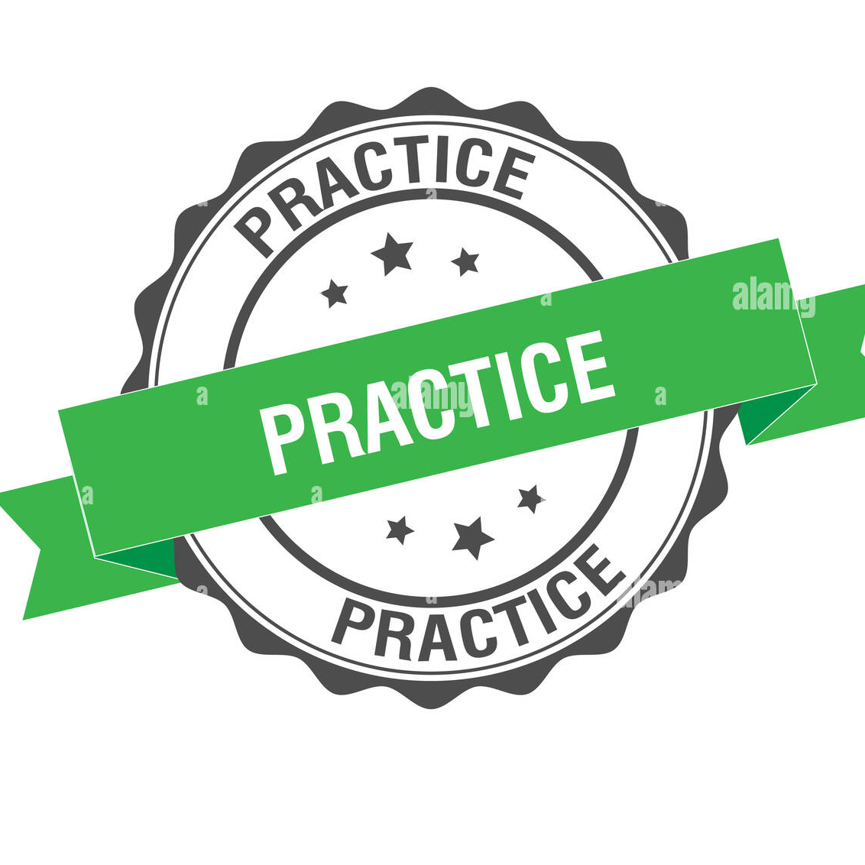
Objectives
Understand how AI & automation can streamline your work
Learn to use ChatGPT for everyday tasks
Explore simple automation with Power Automate
Build confidence with hands-on practice

Slide 3






Agenda
Live Pre-Training Poll
Why AI + Automation Matter
ChatGPT Demo: Summarize Feedback
Group Challenge: Create Prompts
Power Automate Mini-Demo
Live Post-Training Poll
Reflection & Q&A

Slide 4
Live Poll

Slide 5
Why AI + Automation Matter
Save time on repetitive tasks
Focus on higher-value work
Improve accuracy & consistency
Work smarter, not harder

Slide 6

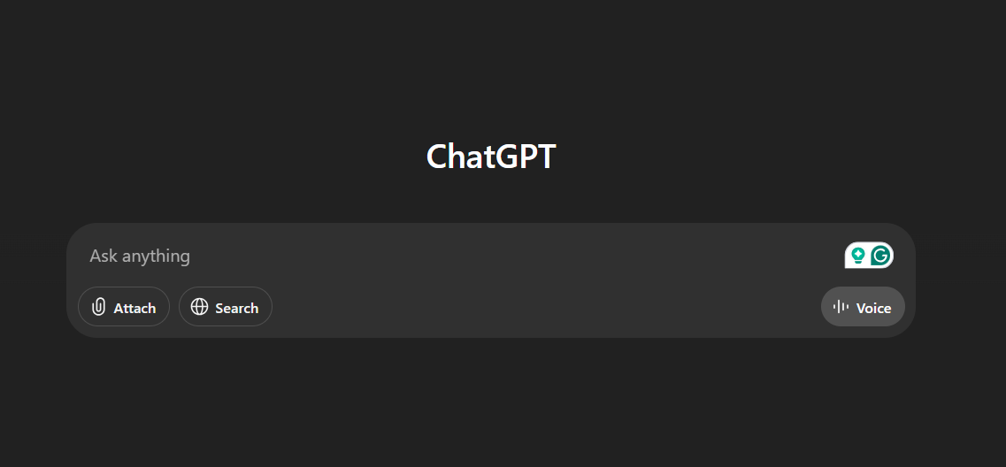
ChatGPT Demo
Task: Summarize student feedback
Feedback is often long and scattered
ChatGPT can quickly extract key points
Example prompt: “Summarize this feedback for me.”

Slide 7
Live Demo

Slide 8


Group Challenge Instructions
Work in pairs or groups of 3
Create prompts for ChatGPT
Draft polite email reminders
Summarize meeting notes
Generate FAQs
Test prompts
Share your best prompt & output

Slide 9

Using ChatGPT Responsibly
Accuracy & Caution
AI can hallucinate facts or give outdated info
Always verify important details before acting on them
Use AI as a starting point, not the final authority
Protect confidential or sensitive data — don’t share private info in prompts
Combine AI insights with your own judgment and expertise

Slide 10
Live Demo

Slide 11
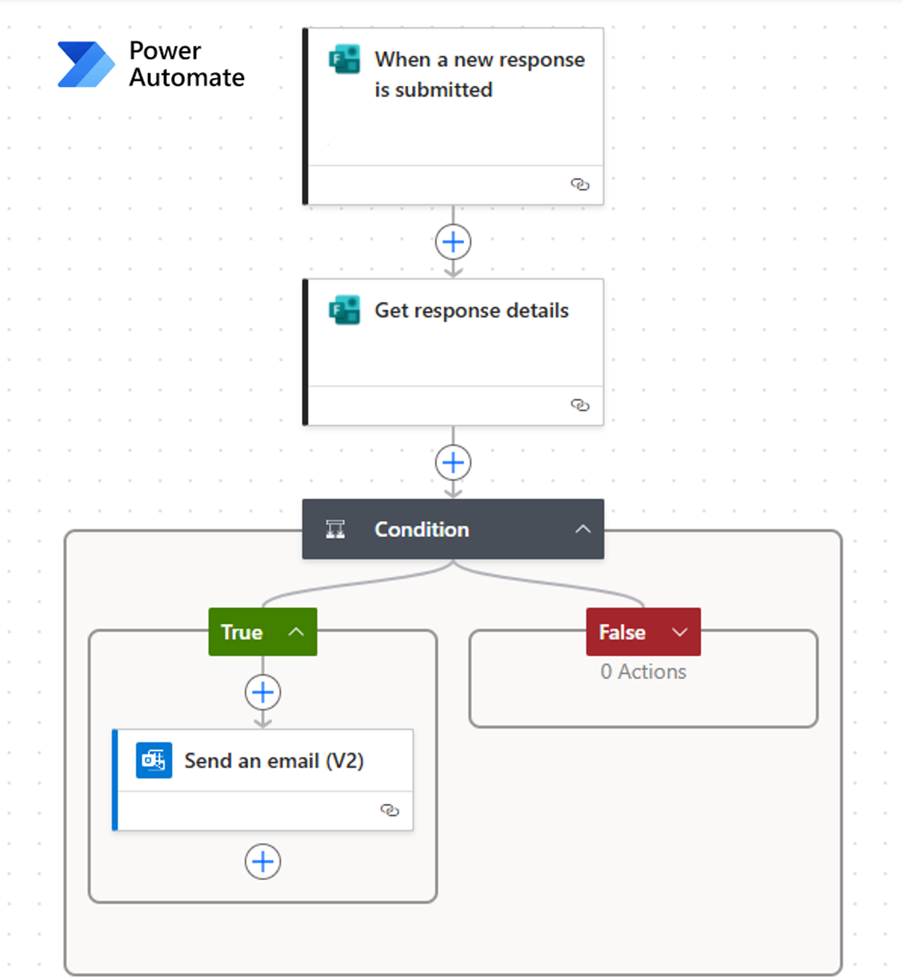
Power Automate Mini-Demo
Example Flow:
Trigger: New Microsoft Form response
Action: Extract key response details
Result: Automatically send a formatted summary via email to relevant staff

Slide 12
Reflection & Next Steps
How will you apply AI or automation in your work?
Resources
ChatGPT: https://chat.openai.com
Power Automate tutorials: https://learn.microsoft.com/power-automate

Slide 13
Live Poll

Slide 14

Thoughts? Questions?
Go ahead, share what you’re thinking!

Slide 15

Thank you for participating!
Let’s keep innovating together!

